Slide 1
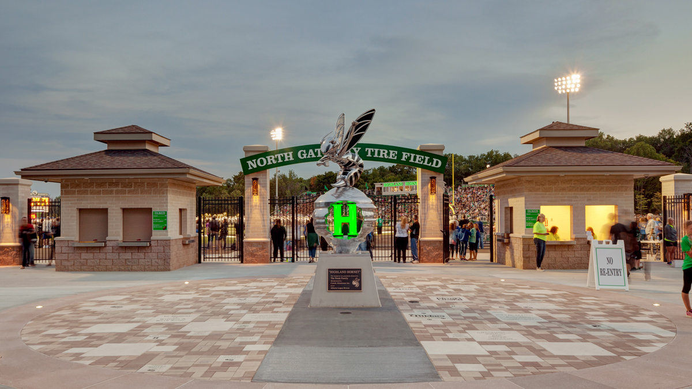
Highland Class of 2024
Parent/Senior Meeting
Notes:
Jim

Slide 2
A Message from Mrs. Killeen
All Seniors will receive a letter with important information about:
- Graduation
- Yearbook
- Dates/Deadlines
Searching for a parent to organize baccalaureate
bkilleen@highlandschools.org
Notes:
Jim

Slide 3
School Counselors:
Mrs. Raines (Mrs. Anderson): A - F
Mrs. Lakins: G - L
Mrs. Colbow: M-R
Mr. Addington: S- Z
Mrs. Norman - Student Services Aide
Notes:
Jim

Slide 4
Communication
Notes:
Chrissi

Slide 5
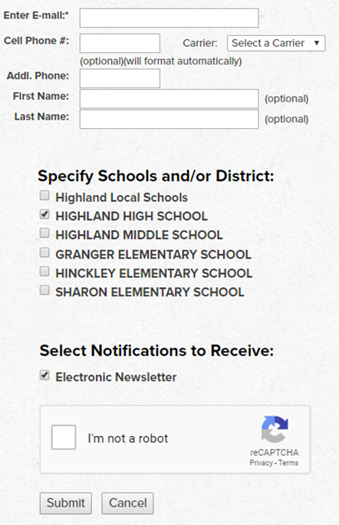
PARENTS/GUARDIANS:
SIGNING UP TO RECEIVE E-COMMUNICATIONS
Go to: www.highlandschools.org/communication
Enter your email
✔ “HIGHLAND HIGH SCHOOL”
✔ “Electronic Newsletter”
✔ I’m not a robot
SUBMIT!
Notes:
Chrissi

Slide 6
From Mr. Murray & Ms. Koval,
Senior Class Advisors
SENIORS: please sign up for the Class of 2024 Google Classroom. This is one way the class officers and Class Advisor will contact you.
Remind: @swarm2024 The classroom code is lwlg2rg
Notes:
Chrissi

Slide 7
Check your email!
Notes:
Chrissi

Slide 8
Graduation Requirements
Notes:
Chrissi

Slide 9
COURSES | CREDITS
English | 4 units | Speech*, English 9, 10, 11, and an elective (A senior year English class is strongly encouraged)
Math | 4 units | Must include Algebra II or equivalent
Science | 3 units | Must include Physical Science (Chemistry and/or Physics), Biology, and an advanced science
Social Studies | 3 units | Must include: World History, US History, Government/Economics (AP Gov fulfills both Gov AND Econ requirements)
World Language | 1 unit
Visual/Performing Arts | 1 unit | Can be Art, Music, or Theater
Health | .5 unit
Physical Education | .5 unit | Two seasons of any sport OR two seasons of marching band exempts students from the PE requirement with a signed PE waiver form submitted to the Counseling Department.
Electives | 4 units | All credits that exceed the above requirements for graduation, count toward a student’s elective requirement.
TOTAL | 21
Notes:
Chrissi- We will be doing a transcript audit at your senior meeting- more info later in the slide show

Slide 10
Reminder…
Athletic & Academic Eligibility Requirements
To be considered a full time student AND athletically eligible:
Must have passed five (5) one credit courses or the equivalent in the preceding grading period and maintain a GPA of <1.5 and be enrolled in at least 2.5 units of study each semester.
http://www.ohsaa.org
Notes:
Chrissi

Slide 11
NCAA Requirements
D1 & D2 athletes- register with NCAA clearing house.
Communicate with your counselor.
The program of studies lists all courses that are NCAA approved.
Notes:
Chrissi 4th quarter junior year for current sports. For spring sports it’s the preceding grading period.

Slide 12
Post-secondary Planning
Notes:
Julie

Slide 13
Enrolled
Enlisted
Employed
Notes:
Julie

Slide 14
ENROLLED
Notes:
Julie

Slide 15
Top 5 Colleges
HHS Students Attend*
Class of 2023
The Ohio State University
Kent State University
The University of Akron
Bowling Green State University
Ohio University
*Based on final transcript request
Notes:
Julie

Slide 16
PLANNING:
We have been already been planning with you for this next step…
Annual grade level meetings
Taking the PSAT & SAT
Meeting with you individually
Juniors: Get 1 excused college visit
Seniors: Plan college visits (2 excused absences)
Counselors have been completing transcript audits each year
Utilizing Naviance (now SchooLinks) platform
College representatives visiting our school
Notes:
Julie

Slide 17
College Admissions Applications
Notes:
Julie

Slide 18
EARLY DECISION
EARLY DECISION = LEGALLY BINDING
Thoroughly read the binding agreement language- each university has different conditions.
Apply early (usually by November) to first-choice college.
Receive an admission decision from the college well in advance of the usual notification date (usually by December).
Apply to only one college early decision.
Apply to other colleges under regular admission plans.
Withdraw all other applications if accepted by ED
Keep in mind the ‘emotional’ decision of this!
Notes:
Julie- it does enhance decisions for competitive admissions schools; each college that offers ED has a different binding agreement. read thoroughly; consult with family and counselors for best plan.

Slide 19
EARLY ACTION
EARLY ACTION = NOT legally binding
TYPICAL EARLY ACTION DEADLINES: NOVEMBER 1, NOVEMBER 15, DECEMBER 1! Check with college deadline on university’s website.
Receive an earlier admission decision
Do not have to commit upon receipt
Can apply to other colleges under regular admission plans
NOTE***** Many Honors Colleges will use this deadline! Colleges will also use this deadline for merit-based scholarships!!!
Notes:
Julie- it does enhance decisions for competitive admissions schools; each college that offers ED has a different binding agreement. read thoroughly; consult with family and counselors for best plan.

Slide 20
ROLLING ADMISSIONS
ROLLING ADMISSIONS– Broader deadlines for admissions
Colleges begin taking applications early (September, October) and continue as late as April.
Your chances of admission will be stronger early on when there are more spaces left to fill, so submit rolling applications before working on your regular decision apps.
The results (acceptance, waitlist, or rejection) could change the rest of your admission strategy.
Notes:
Julie- it does enhance decisions for competitive admissions schools; each college that offers ED has a different binding agreement. read thoroughly; consult with family and counselors for best plan.

Slide 21
SENIOR MEETING WITH COUNSELOR
Senior requests meeting with counselor
Covered:
Graduation Audit
College Choices
How you plan to apply
College Deadlines
NCAA
FAFSA
Ensuring you can navigate SchooLinks
Any questions you have
Notes:
Jim

Slide 22
College Admission Timeline
SEPTEMBER – NOVEMBER
Meet with counselor for individual appointment
Request recommendation letters if needed IN PERSON
Complete ACT/SAT testing (last test September/October)
Attend College Visits**
APPLY
Seniors/parents may meet with the representative from College Now Greater Cleveland for financial aid guidance
Seniors complete ‘institutional’ scholarships
DECEMBER – FEBRUARY
Seniors/parents complete FAFSA form starting in December
Seniors complete local scholarship applications
MAY 1st – National deadline for college commitment/deposit
Notes:
Jim

Slide 23
DEADLINES MATTER
~ Transcripts take up to 10 business days to process.
~Teachers, coaches, counselors & staff need time to prepare letters of recommendations.
~Universities, Military, & Scholarship Foundations don’t make exceptions for missed deadlines!
Notes:
Jim

Slide 24
Applying to College- made EASY!
Process should be student-led!
Student fills out and submits applications
Student uses SchooLinks to organize college applications as well as request transcripts and letters of recommendation to be sent
Student sends ACT and/or SAT scores (if required or student chooses)
Student researches IF college accepts letters of recommendation and how many; asks teachers accordingly
Notes:
Jim

Slide 25
use your personal email
Notes:
Jim

Slide 26
The College Application
Done directly through the college’s website (Institutional) OR through Common App
Common App: students only fill out 1 application and can apply to many, if not all, their colleges
Common App is lengthy! Start early!
Give time for application essays. Honors programs typically have supplemental essays
Students should get another pair of eyes on essays! Parent, teacher, counselor.
BE AWARE OF DEADLINES!
Notes:
Jim

Slide 27
SchooLinks
Used for:
Students requesting transcripts to be sent to colleges
How teachers/counselors send letters of recommendation.
How we know WHERE and WHEN students are applying
College/career exploration
*Note- in order for us to send transcripts to colleges, students MUST REQUEST THEM through SchooLinks!
Notes:
Julie

Slide 28
SchooLinks
Access through Clever Portal
www.highlandschools.org - Quick Links - Student Portal - Clever Portal
Notes:
Julie

Slide 29
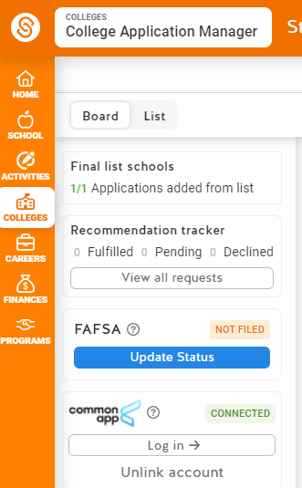
Notes:
Julie

Slide 30
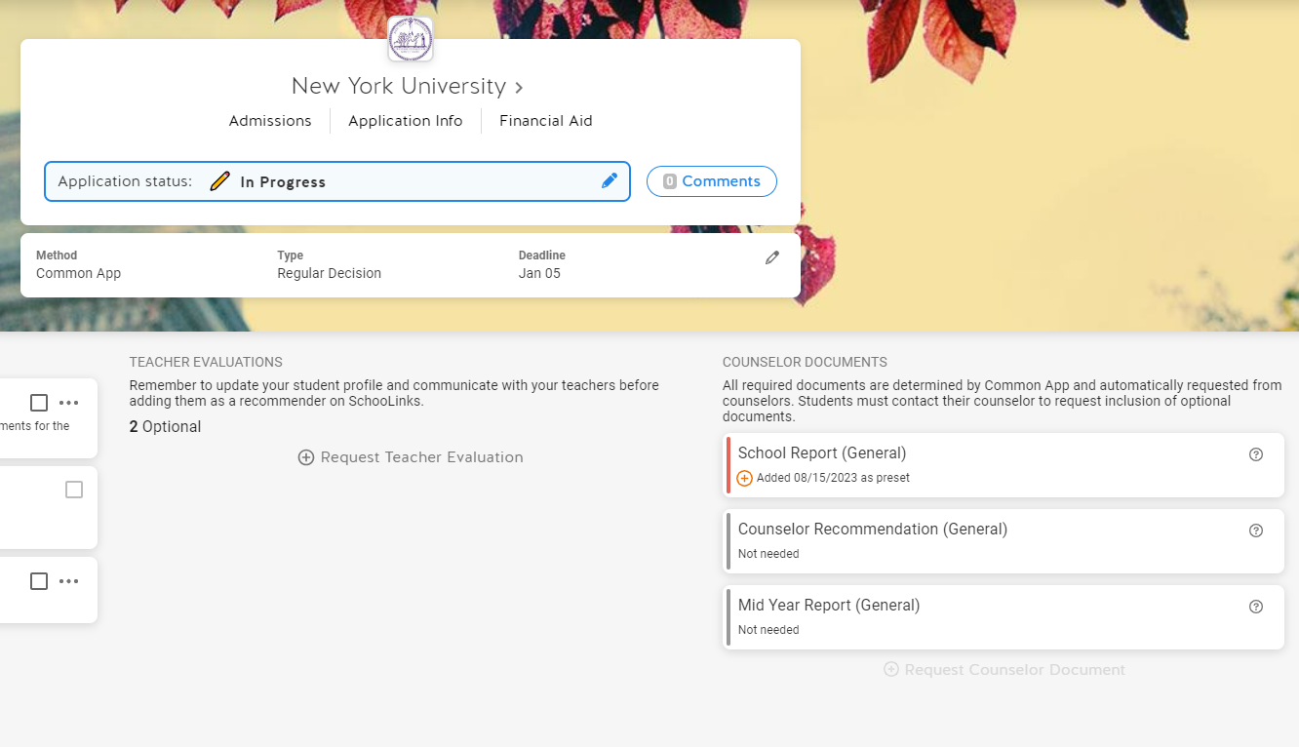
Notes:
Julie

Slide 31
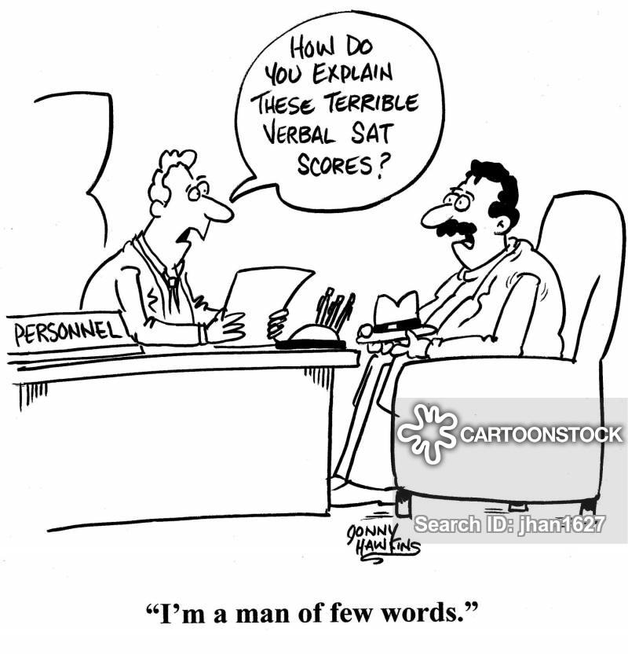
Send ACT / SAT scores
Sent by the STUDENT through the ACT and/or College Board websites
Order scores at least 10 business days before the application deadline
ACT/SAT- can send up to 4 free scores sent to colleges at time of exam. Otherwise $12-13 per score
*Example- Student applying early action to OSU (11/1 deadline), the last date that student could test = September, in order to have scores sent by deadline
If not sure- call admissions offices!
Notes:
Julie

Slide 32
Applying to College
Some colleges may be “test optional” this fall: ACT/SAT scores are not required as part of the application
Register for in person or virtual college campus tours and virtual college fairs!!! This shows ‘demonstrated interest’
Communicate/email with College of Admissions directly to demonstrate interest
Still look for opportunities to get involved
Notes:
Julie

Slide 33
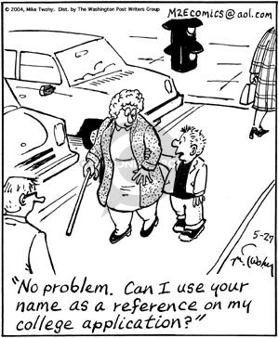
Letters of Recommendation
Be aware- many colleges today only accept a MAXIMUM of 1-2 letters. Some do not even require them
Do not submit additional letters above the requirement. They won’t be read.
Student asks teacher IN PERSON first!
If “yes”- hand-deliver resume to teacher
THEN- student must request the letter
through SchooLinks
Teachers submit their letters via SchooLinks
Letters do not have to be submitted when
student submits application, but letter
needs to be in by application deadline!
Make sure teachers are aware of deadlines-
give plenty of time!
Notes:
Julie

Slide 34
November 1st
October 18th
Request minimum 10 school days before deadline. Example:
Notes:
Julie

Slide 35
ENLISTED
Notes:
Chrissi

Slide 36
MILITARY ENLISTMENT
Army, Navy, Air Force, Marine Corps, Coast Guard
Must be at least 17 years old (with parental consent)
Must have recruiter
Pass ASVAB at MEPS testing location
Pass MEPS physical exam
Meet with enlistment counselor to determine career
Complete oath of enlistment
Notes:
Chrissi - about once a month there are military reps on campus answering questions

Slide 37
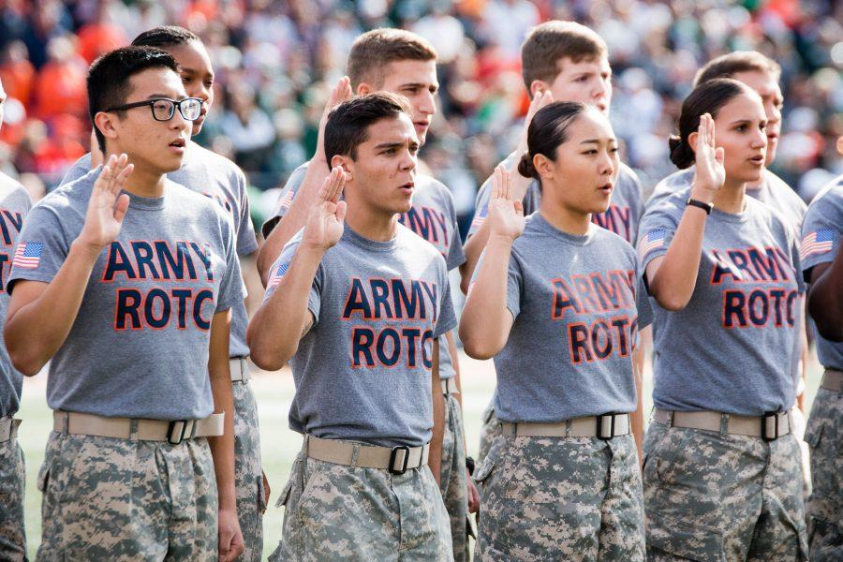
ROTC- Reserve Officers' Training Corps
A college program offered at more than 1,000 colleges and universities across the United States.
ROTC prepares young adults to become Officers in the U.S. Army.
ROTC is a college elective; there is no obligation until a student’s junior year.
ROTC is not a major; almost every major is compatible with the program.
There is no military obligation for service until student’s junior year in college unless an ROTC scholarship is awarded.
Notes:
Chrissi

Slide 38
Lake
Ashtabula
Toledo
Williams
Fulton
Swanton
Walbridge
Camp Perry
Lucas
Ottawa
Chagrin Falls
Sandusky
Lorain
Brook Park
Geauga
Trumbull
Defiance
Henry
Sandusky
Erie
Cuyahoga
Wood
Norwalk
Medina
Stow
Portage
Newton Falls
TC
Paulding
Lorain
Medina
Tiffin
Youngstown
Putnam
Hancock
Seneca
Huron
Ashland
Summit
Mahoning
Wyandot
Ashland
Wayne
Alliance
CO F 128 FSC (MNVR)
MP
Van Wert
Kirby
Crawford
Mansfield
Wooster
Stark
Lima
TC
North Canton
Columbiana
Allen
Hardin
Richland
1486
Mercer
St Marys
Marion
Holmes
Tuscarawas
Carroll
Auglaize
Marion
Morrow
Jefferson
Marysville
Delaware
Knox
Coshocton
Dover
Shelby
Bellefontaine
585
1485
Harrison
Greenville
Logan
Delaware
Coshocton
Miami
Champaign
Union
Newark
Guernsey
Franklin
Belmont
Darke
Piqua
Clark
Licking
Dayton
Springfield
Zanesville
Eaton
Greene
Fairfield
Muskingham
Noble
Monroe
Madison
Pickaway
Perry
Morgan
Preble
Montgomery
Xenia
EN
McConnelsville
Warren
Fayette
Tarlton
Hamilton
Middletown
Ross
Hocking
Washington
Butler
Clinton
Hamilton
Lebanon
Vinton
Athens
Chillicothe
Ohio Univ.
Woodlawn
Highland
Cincinnati
Pike
Meigs
Clermont
Jackson
Brown
Adams
Scioto
Ripley
Gallia
Portsmouth
AD
Lawrence
AG
Notes:
Chrissi

Slide 39
WHAT’S NEXT?
Notes:
Chrissi

Slide 40
Monday, September 11th:
Mandatory Senior Meeting during ALL
No Open Campus this day!
Notes:
Chrissi

Slide 41
JUNIOR JUMP-START!
Counselors use this to write accurate letters of recommendation. All current seniors will receive a link tomorrow in their inbox.
Notes:
Chrissi

Slide 42
Save the Dates and
College Now Introduction
Anne Gates- College Now Advisor
FAFSA Night and College Now Meeting
Thursday, September 21st at 6:00 PM
Scholarship Meeting
TBD in January
1:1 Financial Aid Meetings throughout the year
Notes:
Anne Gates

Slide 43
Save the Dates (Continued):
College Now Workshops - During ALL
October 5th: College Application Workshop
October 17th: College Application Workshop
November 16th: Institutional Scholarships Workshop
February 8th: Local Scholarship Workshop
February 23rd: Local Scholarship Workshop
March 5th: Local Scholarship Workshop
Open Campus students are encouraged to stay for these!
Notes:
Anne Gates

Slide 44
NEXT STEPS!
Schedule an individual appointment with your counselor after Senior Meeting (For Mrs. Lakins’ caseload: students received an email to access scheduling blocks earlier than this due to her maternity leave)
These can be done through Zoom as well
Narrow down your college list and start working on applications. Begin essays!
Ask teachers for letters of rec (IF needed)
Send your ACT/SAT scores to schools you apply to and/or register to re-test!
Notes:
Jim

